Slide 1
Magnetic Braking Data Analysis Presentation Team 2
William Bardell (primary analyst)
Notes:
Today I am going to be presenting on the data analysis section of the magnetic braking experiment for team 2.

Slide 2
Our aims
Test the effect of the magnetic field strength B on the deceleration. We would achieve this by measuring the rate of decay at several different speeds for different magnetic field strength
Notes:
Rate of deceleration of the disk. And modelling the decay as exponential, as can be seen in the following slide

Slide 3
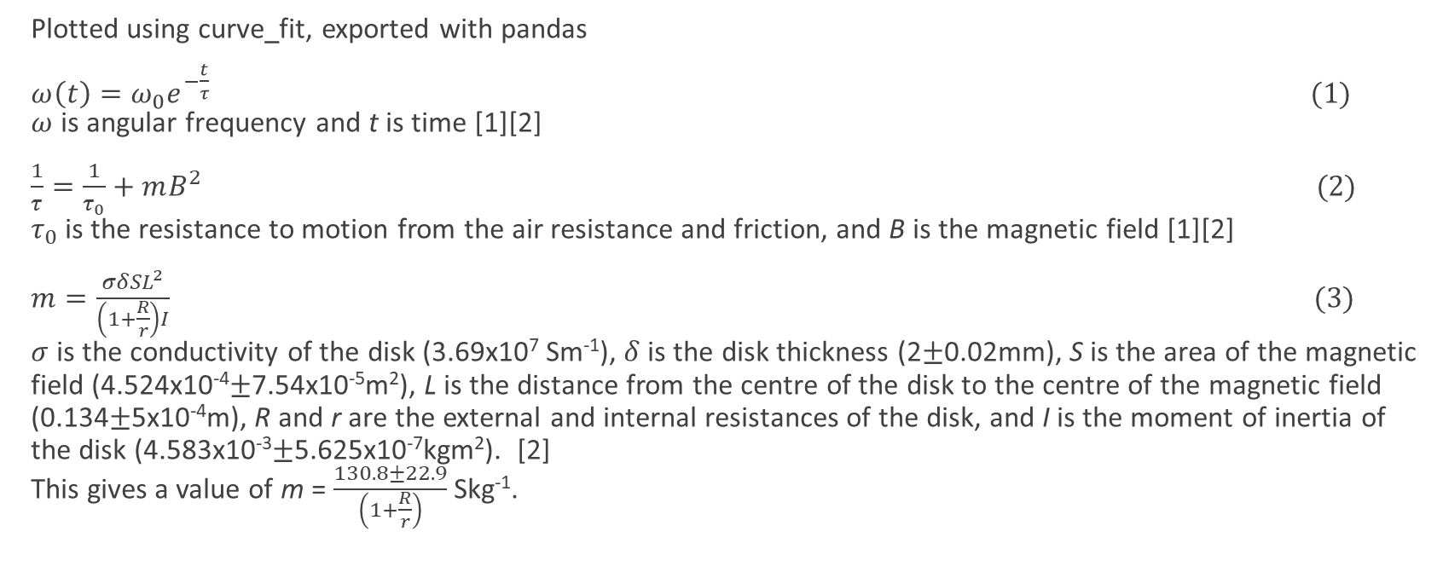
The maths
Plotted using curve_fit, exported with pandas
$ω\left(t\right)=ω_{0}e^{−\frac{t}{τ}} (1)$ $ω$ is angular frequency and t is time [1][2]
$\frac{1}{τ}=\frac{1}{τ_{0}}+mB^{2} (2)$ $τ_{0}$ is the resistance to motion from the air resistance and friction, and B is the magnetic field [1][2]
$m=\frac{σδSL^{2}}{\left(1+\frac{R}{r}\right)I} (3)$ $σ$ is the conductivity of the disk (3.69x10⁷ Sm⁻¹), $δ$ is the disk thickness (2±0.02mm), S is the area of the magnetic field (4.524x10⁻⁴±7.54x10⁻⁵m²), L is the distance from the centre of the disk to the centre of the magnetic field (0.134±5x10⁻⁴m), R and r are the external and internal resistances of the disk, and I is the moment of inertia of the disk (4.583x10⁻³±5.625x10⁻⁷kgm²). [2] This gives a value of m = $\frac{130.8±22.9}{\left(1+\frac{R}{r}\right)}$ Skg⁻¹.
Notes:
Don’t bother with actual values- just give final value for m

Slide 4
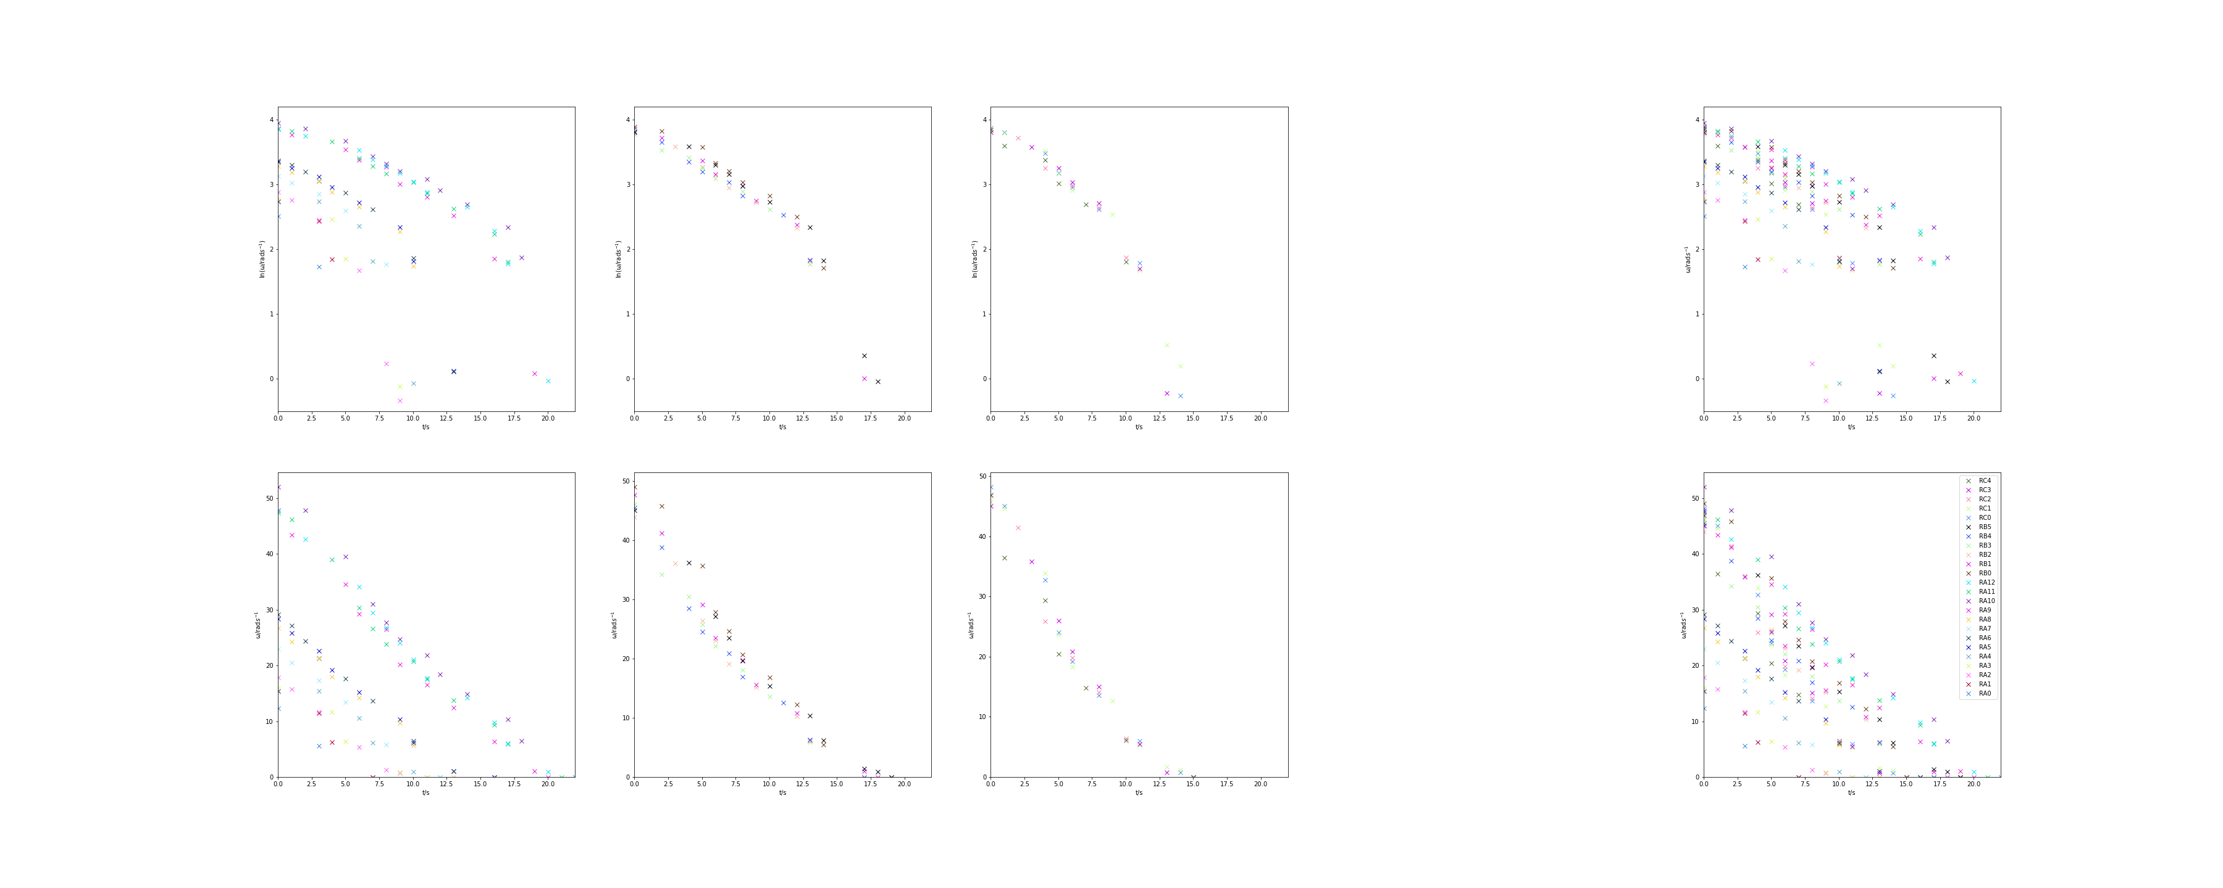

B=38.6mT
B=55.3mT
B=72.4mT
All data
Log of data
Data
Notes:
Data looks linear, but by closer inspection it follows an exponential decay- can be seen more clearly in RA5
The log plot shows two separate linear trends, which can be plotted like this

Slide 5
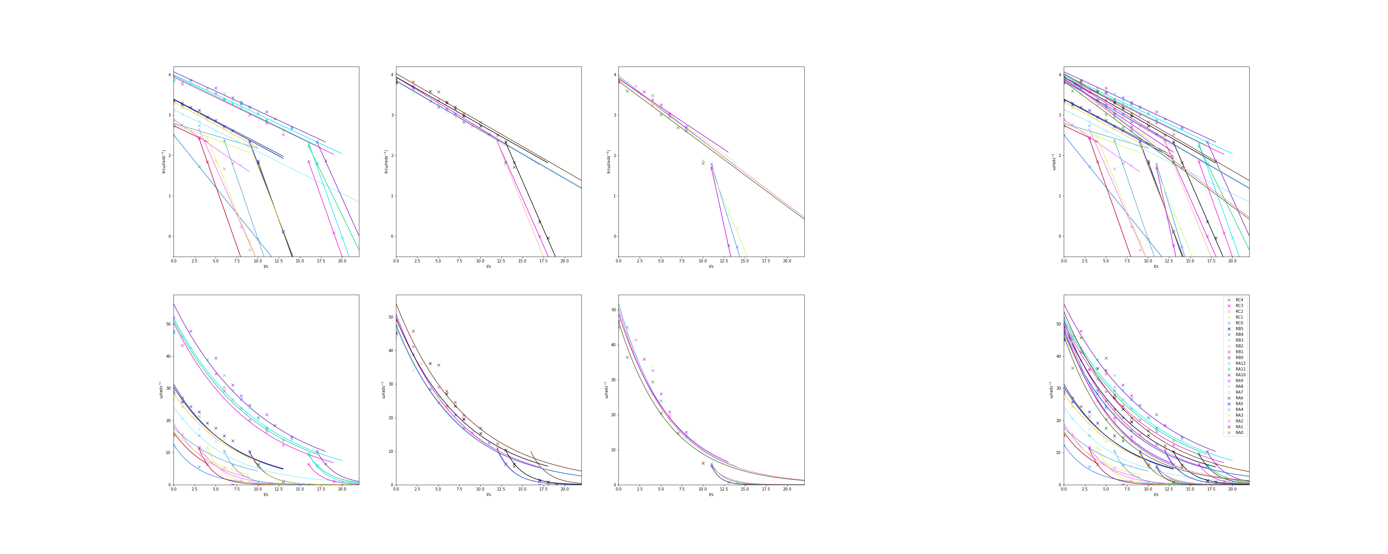
B=38.6mT
B=55.3mT
B=72.4mT
All data
Log of data
Data
Notes:
The secondary plot implies may imply some regime where the resistance to motion from air resistance and friction becomes more significant, but this should be predicted by equations 1 and 2.
Not all plots show secondary plot- due to the nature of the tachometer, there are not always enough points to find a trend (most only have about 3). This may be possible with more measurements
Colours vary in visibility- due to the way they were assigned, only way to keep them consistent across all plots

Slide 6
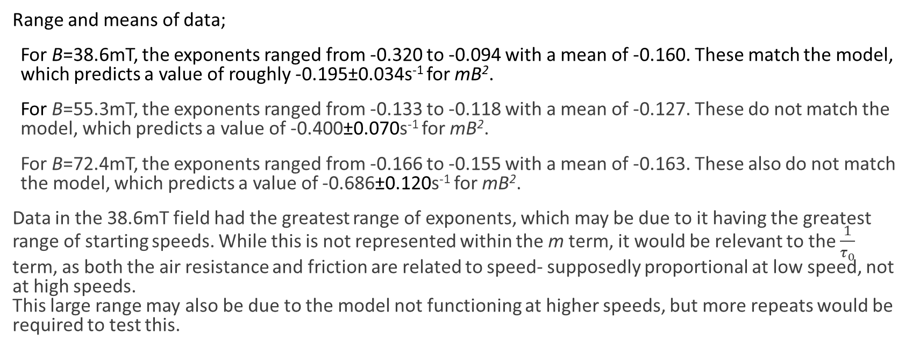
Specific analysis
Range and means of data;
For B=38.6mT, the exponents ranged from -0.320 to -0.094 with a mean of -0.160. These match the model, which predicts a value of roughly -0.195±0.034s⁻¹ for mB².
For B=55.3mT, the exponents ranged from -0.133 to -0.118 with a mean of -0.127. These do not match the model, which predicts a value of -0.400±0.070s⁻¹ for mB².
For B=72.4mT, the exponents ranged from -0.166 to -0.155 with a mean of -0.163. These also do not match the model, which predicts a value of -0.686±0.120s⁻¹ for mB².
Data in the 38.6mT field had the greatest range of exponents, which may be due to it having the greatest range of starting speeds. While this is not represented within the m term, it would be relevant to the $\frac{1}{τ_{0}}$ term, as both the air resistance and friction are related to speed- supposedly proportional at low speed, not at high speeds. This large range may also be due to the model not functioning at higher speeds, but more repeats would be required to test this.
Notes:
Don’t go into specifics- relative closeness at 38mT, discuss range of values and range of speeds

Slide 7
Issues with this set of data
Most measurements start at roughly the same speed- mean is 37.08 rads⁻¹ Data for high speeds fits the correct trend, but not at the expected values.
Different number of sets of measurements for different magnetic fields (13,6,5)
Only 3 values of magnetic field
First set of measurements has 3 data points- not really enough to establish a trend
Blank space- forward fill vs numpy.isfinite
Data given in 16xrpm

Slide 8
Conclusions
Equation 1 holds for low speeds, but may need refining at higher speeds.
Equation 1 holds for the 38.6mT magnetic field, but due to the model being inconsistent at higher speeds, more measurements need to be taken at lower starting speeds
Needs more data so there are a greater range of values to plot
Notes:
And in general, we need more data so we can do an effective error analysis.

Slide 9
References+ Acknowledgments
[1] DOCUMENT: P. Snow. Magnetic Braking Maths Notes For Y2.
[2] ARTICLE: H. D. Wiederick, N. Gauthier, D. A. Campbell, and P. Rochon. Magnetic braking: Simple theory and experiment. American Journal of Physics, 1987, 55, p500-503
Acknowledgements
Ben Andrews (secondary analyst) for help with coding and for pointing out the secondary gradient in the log plot.
Notes:
Any Questions?

